Slide 1

N & Q Choices
By
Francisco Soriano

Slide 2

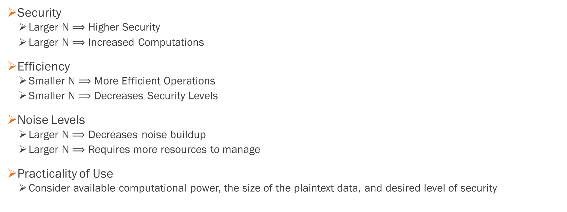
Motivations for N
Security
Larger N $⟹$ Higher Security
Larger N $⟹$ Increased Computations
Efficiency
Smaller N $⟹$ More Efficient Operations
Smaller N $⟹$ Decreases Security Levels
Noise Levels
Larger N $⟹$ Decreases noise buildup
Larger N $⟹$ Requires more resources to manage
Practicality of Use
Consider available computational power, the size of the plaintext data, and desired level of security

Slide 3
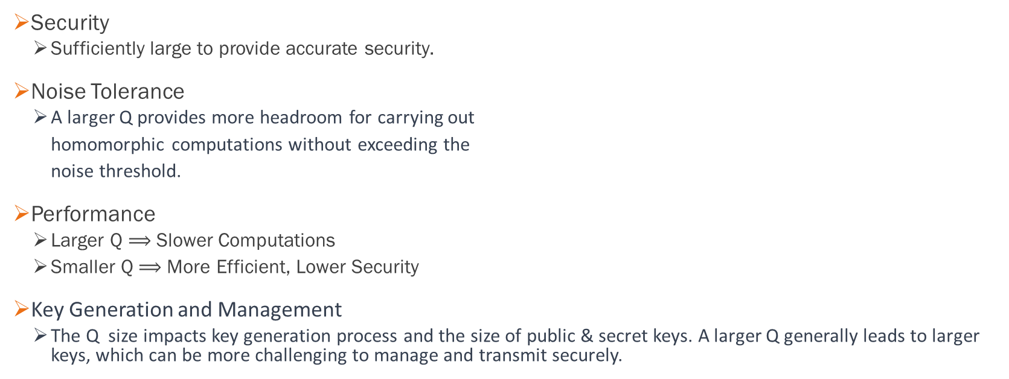
Motivations for Q
Security
Sufficiently large to provide accurate security.
Noise Tolerance
A larger Q provides more headroom for carrying out
homomorphic computations without exceeding the
noise threshold.
Performance
Larger Q $⟹$ Slower Computations
Smaller Q $⟹$ More Efficient, Lower Security
Key Generation and Management
The Q size impacts key generation process and the size of public & secret keys. A larger Q generally leads to larger keys, which can be more challenging to manage and transmit securely.

Slide 4
Q-Value Considerations for all Schemes
The noise grows as encrypted computations are performed, and the main functional parameter in all these schemes, the ciphertext modulus Q, needs to be large enough to accommodate the noise growth, or a special bootstrapping procedure may be used to reset the noise and keep the value of Q relatively small.
In the case of BGV-like schemes, such as BGV, BFV, and CKKS, the ciphertext modulus Q is often much larger than the standard machine word size of 64 bits.
Q is a prime number with hundreds or even thousands of bits that relate directly to the HE
Reference
S. Fan, Z. Wang, W. Xu, R. Hou, D. Meng and M. Zhang, "TensorFHE: Achieving Practical Computation on Encrypted Data Using GPGPU," 2023 IEEE International Symposium on High-Performance Computer Architecture (HPCA), Montreal, QC, Canada, 2023, pp. 922-934, doi: 10.1109/HPCA56546.2023.10071017.

Slide 5
FHE Schemes based on RLWE
N - a power-of-two ring dimension that is typically in the range from 2¹⁰ to 2¹⁷
NTT provides an O(N*log(N)) computational complexity.
BGV: (N= 2¹⁰ to 2¹⁷, Q= >2⁶⁴)
CKKS: (N= 2¹⁰ to 2¹⁷, Q= >2⁶⁴)
BGV & CKKS: N and Q Choices
Reference
OpenFHE: Open-Source Fully Homomorphic Encryption Library - IACR, eprint.iacr.org/2022/915.pdf. Accessed 15 Oct. 2023.

Slide 6
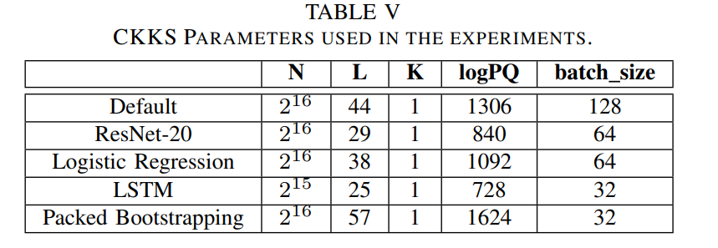
TensorFHE: Achieving Practical Computation on Encrypted Data Using GPGPU
CKKS: N and Q Choices
Reference
S. Fan, Z. Wang, W. Xu, R. Hou, D. Meng and M. Zhang, "TensorFHE: Achieving Practical Computation on Encrypted Data Using GPGPU," 2023 IEEE International Symposium on High-Performance Computer Architecture (HPCA), Montreal, QC, Canada, 2023, pp. 922-934, doi: 10.1109/HPCA56546.2023.10071017.

Slide 7
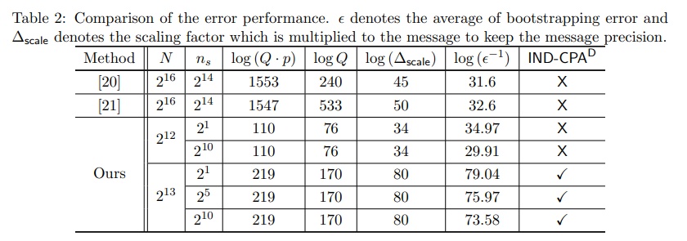
General Bootstrapping Approach for RLWE-based Homomorphic Encryption
CKKS: N and Q Choices
Reference
A. Kim et al., "General Bootstrapping Approach for RLWE-based Homomorphic Encryption," in IEEE Transactions on Computers, doi: 10.1109/TC.2023.3318405.

Slide 8
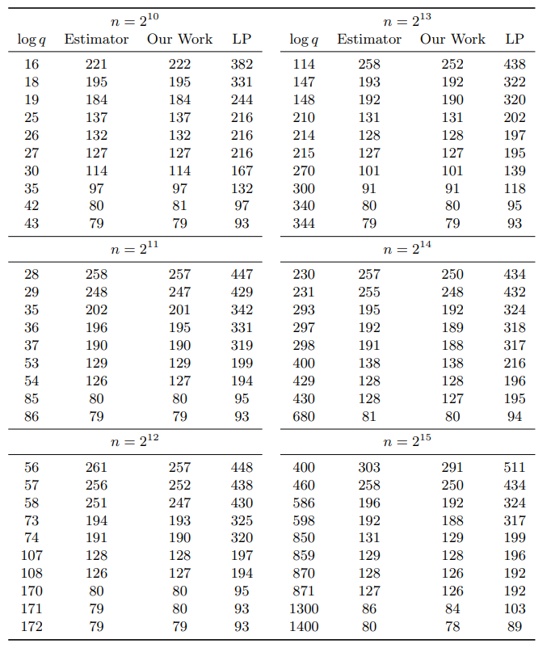
Finding and Evaluating Parameters for BGV
BGV: N and Q Choices
References
Mono, Johannes, et al. “Finding and Evaluating Parameters for BGV.” Cryptology ePrint Archive, 29 May 2023, eprint.iacr.org/2022/706.

Slide 9
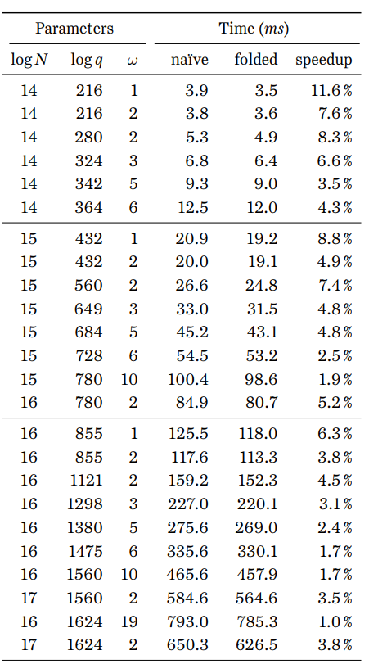
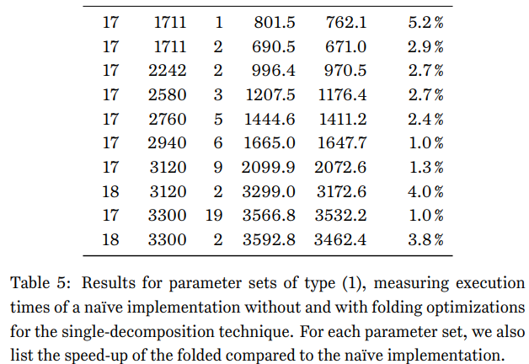
A New Perspective on Key Switching for BGV-like Schemes (Pt 1)
BGV: N and Q Choices
Reference
ANEWPERSPECTIVEONKEYSWITCHINGFORBGV-Likeschemes, eprint.iacr.org/2023/1642.pdf. Accessed 30 Oct. 2023.

Slide 10
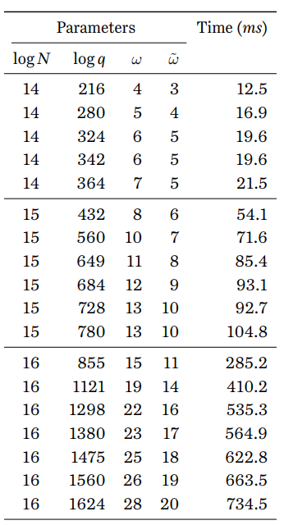
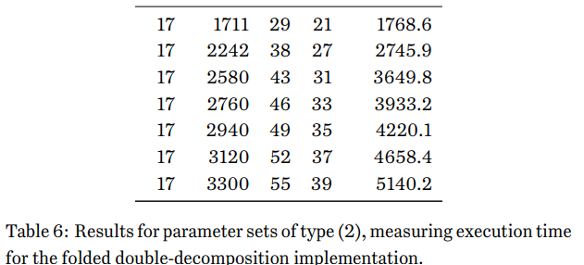
A New Perspective on Key Switching for BGV-like Schemes (Pt 2)
BGV: N and Q Choices
Reference
ANEWPERSPECTIVEONKEYSWITCHINGFORBGV-Likeschemes, eprint.iacr.org/2023/1642.pdf. Accessed 30 Oct. 2023.

Slide 11
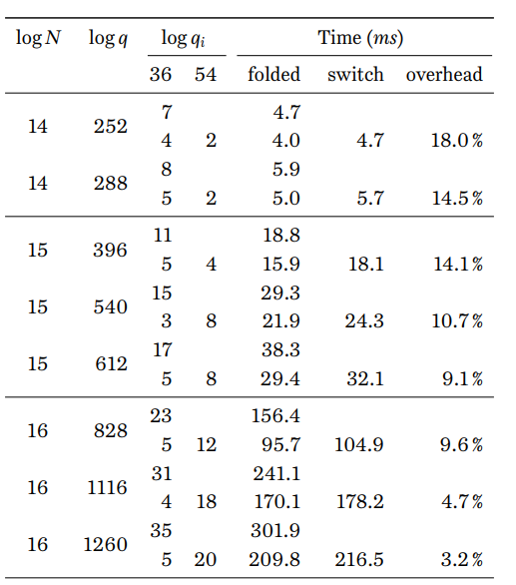
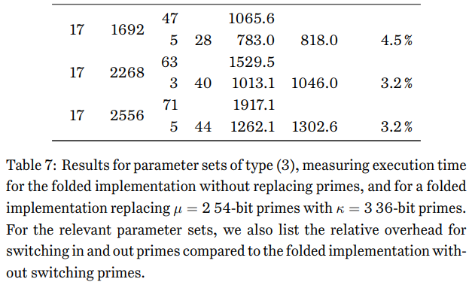
A New Perspective on Key Switching for BGV-like Schemes (Pt 3)
BGV: N and Q Choices
Reference
ANEWPERSPECTIVEONKEYSWITCHINGFORBGV-Likeschemes, eprint.iacr.org/2023/1642.pdf. Accessed 30 Oct. 2023.

Slide 12
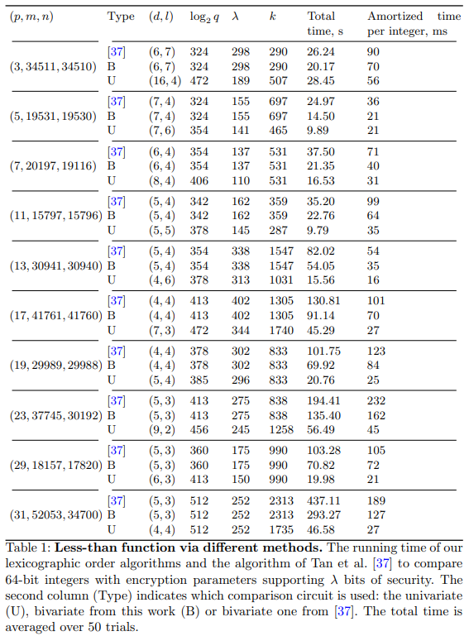
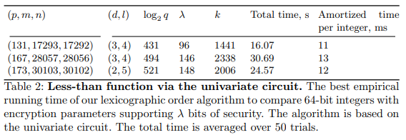
Faster homomorphic comparison operations for BGV and BFV (Pt 1)
BGV: N and Q Choices
Reference
Ilia Iliashenko, Vincent Zucca. Faster homomorphic comparison operations for BGV and BFV. Proceedings on Privacy Enhancing Technologies, 2021, 2021 (3), pp.246-264. ff10.2478/popets-2021-0046ff. ffhal-03506798f

Slide 13
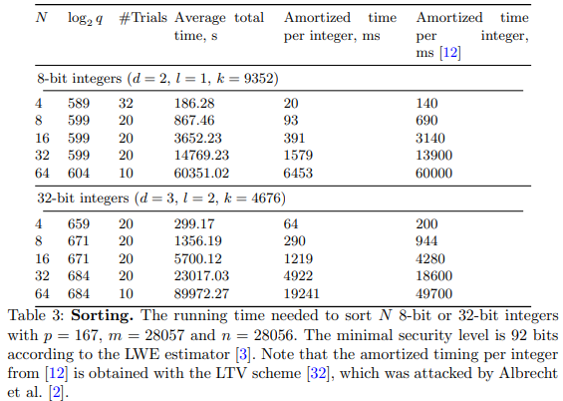
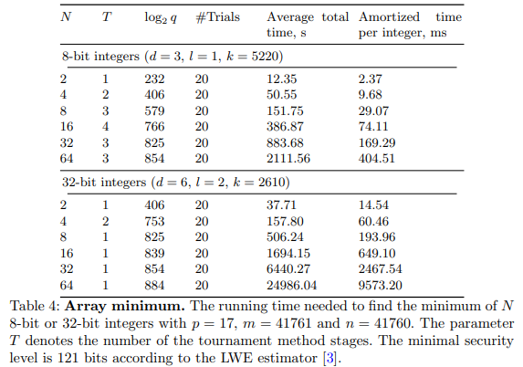
Faster homomorphic comparison operations for BGV and BFV (Pt 2)
BGV: N and Q Choices
Reference
Ilia Iliashenko, Vincent Zucca. Faster homomorphic comparison operations for BGV and BFV. Proceedings on Privacy Enhancing Technologies, 2021, 2021 (3), pp.246-264. ff10.2478/popets-2021-0046ff. ffhal-03506798f

Slide 14
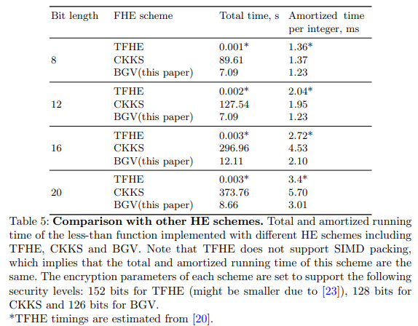
Faster homomorphic comparison operations for BGV and BFV (Pt 3)
BGV: N and Q Choices
Reference
Ilia Iliashenko, Vincent Zucca. Faster homomorphic comparison operations for BGV and BFV. Proceedings on Privacy Enhancing Technologies, 2021, 2021 (3), pp.246-264. ff10.2478/popets-2021-0046ff. ffhal-03506798f

Slide 15
Optimization of Homomorphic Comparison Algorithm on RNS-CKKS Scheme
CKKS = (2¹⁶, 2⁶⁰)
CKKS: N and Q Choice
Reference
E. Lee, J. -W. Lee, Y. -S. Kim and J. -S. No, "Optimization of Homomorphic Comparison Algorithm on RNS-CKKS Scheme," in IEEE Access, vol. 10, pp. 26163-26176, 2022, doi: 10.1109/ACCESS.2022.3155882.

Slide 16
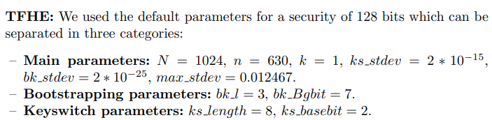
BFV, CKKS, TFHE: Which One is the Best for a Secure Neural Network Evaluation in the Cloud?
CKKS: (N = 2^14, 2^280)
TFHE: (N = 2^10)
CKKS & TFHE: N and Q Choices
References
Clet, PE., Stan, O., Zuber, M. (2021). BFV, CKKS, TFHE: Which One is the Best for a Secure Neural Network Evaluation in the Cloud?. In: Zhou, J., et al. Applied Cryptography and Network Security Workshops. ACNS 2021. Lecture Notes in Computer Science(), vol 12809. Springer, Cham. https://doi.org/10.1007/978-3-030-81645-2_16

Slide 17
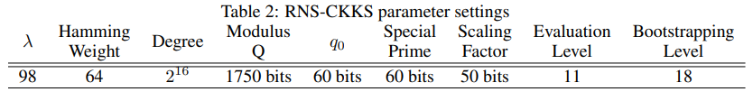
Privacy-Preserving Machine Learning with Fully Homomorphic Encryption for Deep Neural Network
BGV: N and Q Choice
References
ArXiv:2106.07229v1 [Cs.LG] 14 Jun 2021, arxiv.org/pdf/2106.07229. Accessed 29 Oct. 2023

Slide 18
Making RLWE FHE practical: CRT and NTT
Q Choices = 2¹⁸⁰ , 2⁸⁸¹
Reference:
OpenFHE: Open-Source Fully Homomorphic Encryption Library Accelerating Number Theoretic Transformations for Bootstrappable Homomorphic Encryption on GPUs

Slide 19
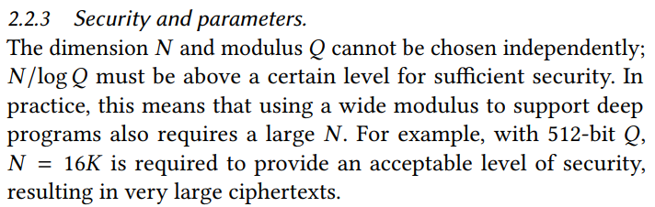
F1: A Fast and Programmable Accelerator for Fully Homomorphic Encryption
BGV = (2¹⁴, 2⁵¹²)
BGV: N and Q Choices
Reference
F1: A Fast and Programmable Accelerator for Fully Homomorphic ... - People, people.csail.mit.edu/devadas/pubs/micro21_fhe.pdf. Accessed 16 Oct. 2023.

Slide 20
BGV Choice Analysis

Slide 21
CKKS Choice Analysis

Slide 22
Thank you
321-603-9123
fr015568@ucf.edu

